Slide 1


Basics of Insurance

Slide 2



Slide 3
Common Risks or Uncertainties faced by us!
Death Disease Disability

Slide 4


Insurance is a risk management tool; used to transfer risk to a third party (insurance company)
Insurance is a legal contract between Insured and Insurer is known as ‘Policy’ (Insured – Policyholder & Insurer – Insurance Company)
Promise by insured to pay premium
Promise by insurer to pay for the accepted risk to the insured/family at the time of risk occurrence/uncertainty
Insurance Company compensates of Financial Losses at the time of risk occurrence/uncertainty

Slide 5
How Big a player is policybazaar in term insurance?
3525 Cr
Insurer | In crores, FY 23-24
SBI Life | 900
Max Life | 613
HDFC Life | 590
TATA AIA | 579
ICICI Pru Life | 478
Bajaj | 225
Others | 140
Total Market | 3,525
825 Cr
Practically 2nd largest insurance company
23%
Term APE in FY 23-24
PB’s Term APE in FY 23-24

Slide 6


How Insurance Company Works?

Slide 7




How Insurance Works?
Large Group of People Paying Premium for similar risks to the insurer
Insurers further invest the money to multiply it & create a large pool of money
Money Pool used to settle claims of people facing uncertainty/risks
RISK POOLING IN INSURANCE Not everyone will experience the insured risk/uncertainty at the same time, but those who do are financially compensated from this risk pool (premiums collected from customers)

Slide 8

Insurance Regulatory & Development Authority of India
IRDAI is a body tasked with regulating and promoting insurance in India It was constituted by the Insurance Regulatory and Development Authority Act - IRDA Act, 1999 It came in operations in 2000s IRDAI’s headquarters are in Hyderabad, Telangana.

Slide 9
Functions of IRDAI: Protect the interests of the policyholders
Issuing the registration certificates to insurance companies and regulate them
Provide licenses to insurance intermediaries like agents and brokers after stating the required qualifications and set guidelines for their code of conduct
Promote and regulate professional organisations related to insurance to enhance the development of the sector Regulate and supervise the premium rates and terms of the insurance policies
Specify the conditions and manners by which the insurance companies have to present their financial reports
Regulate the investment of the policyholders’ funds by the insurance companies
Ensure the maintenance of the solvency margin i.e. the ability of an insurance company to pay out claims

Slide 10
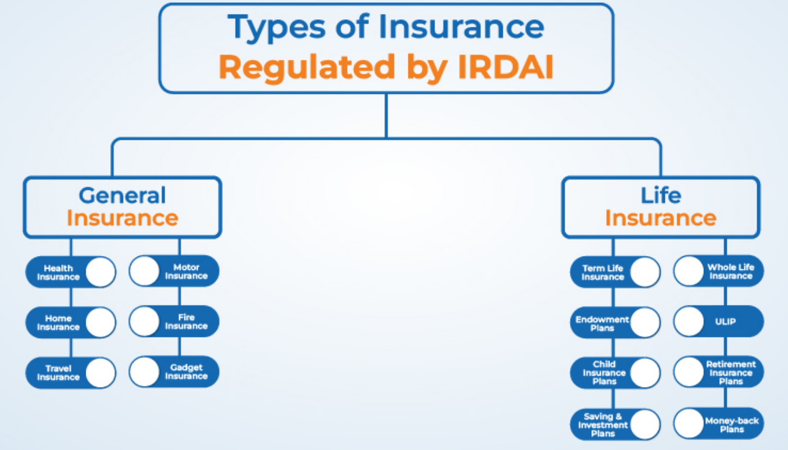

Slide 11
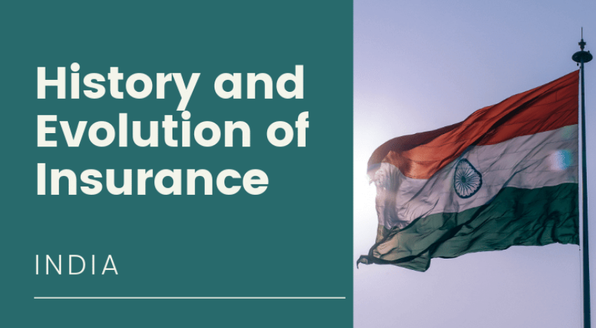

Slide 12

Marine Insurance 15th century London, United Kingdom
Fire Insurance 1680 London, United Kingdom
Life Insurance 1706 London, United Kingdom
Bottomry Contracts Ship merchants of Babylon (modern –day Iraq) 3000 BC

Slide 13
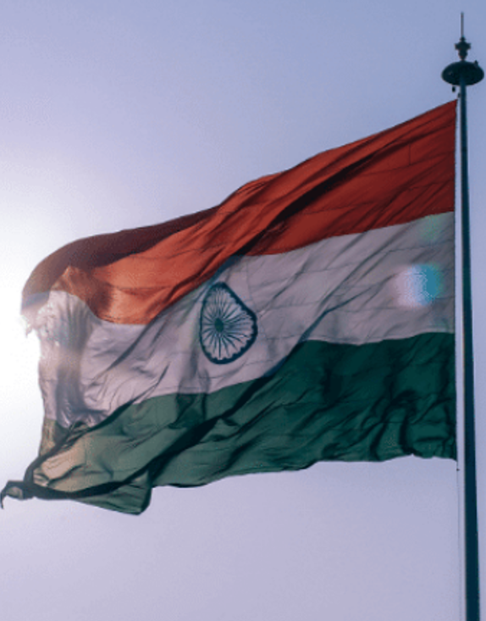
1870 First insurance policy issued in India
1938 The Insurance Act was enforced
1956 LIC of India formed after nationalization of 245 private life insurers
1972 4 Public Sector General Insurance Companies formed after nationalization of 107 general insurers (National, New India Assurance, Oriental & United India)
1993 Foreign investment in Indian insurance industry recommended by committee set up under the chairmanship of RN Malhotra the former RBI Governor
2000 Insurance sector opened up in India for private players Eg – ICICI, TATA, HDFC, etc
1999 IRDAI was formed to regulate Insurance in India

Slide 14
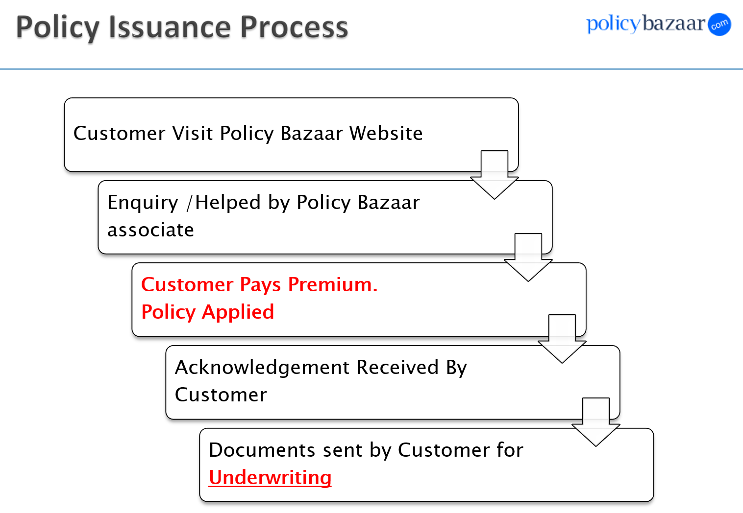

Slide 15
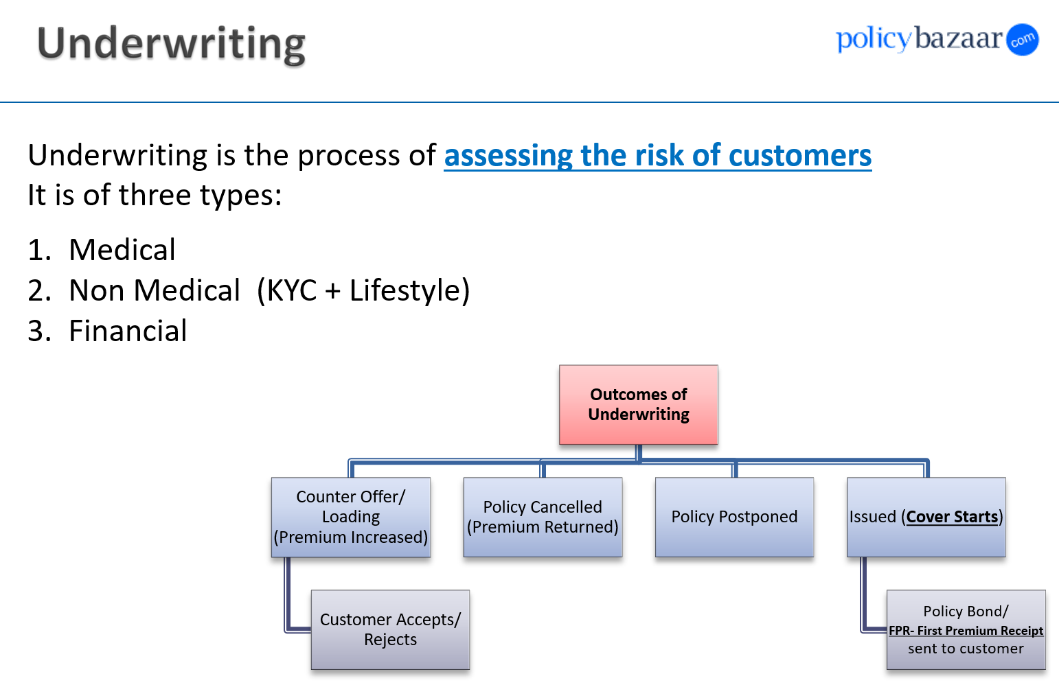

Slide 16
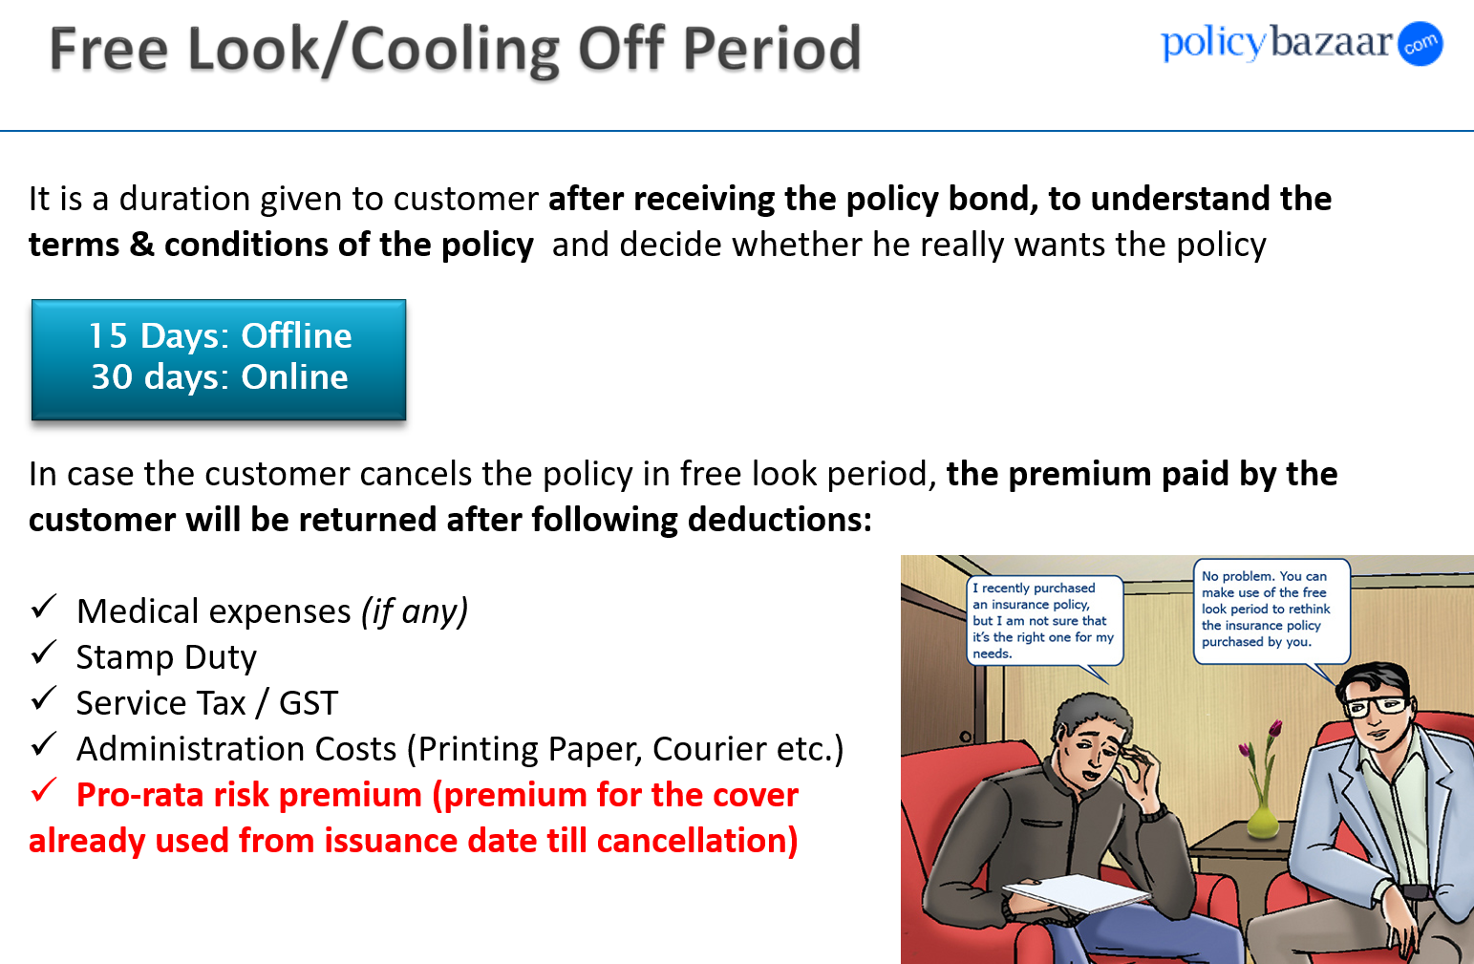

Slide 17
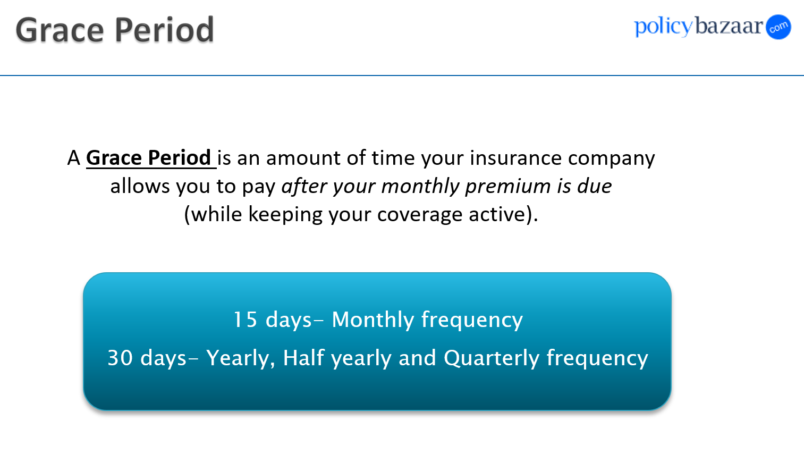

Slide 18
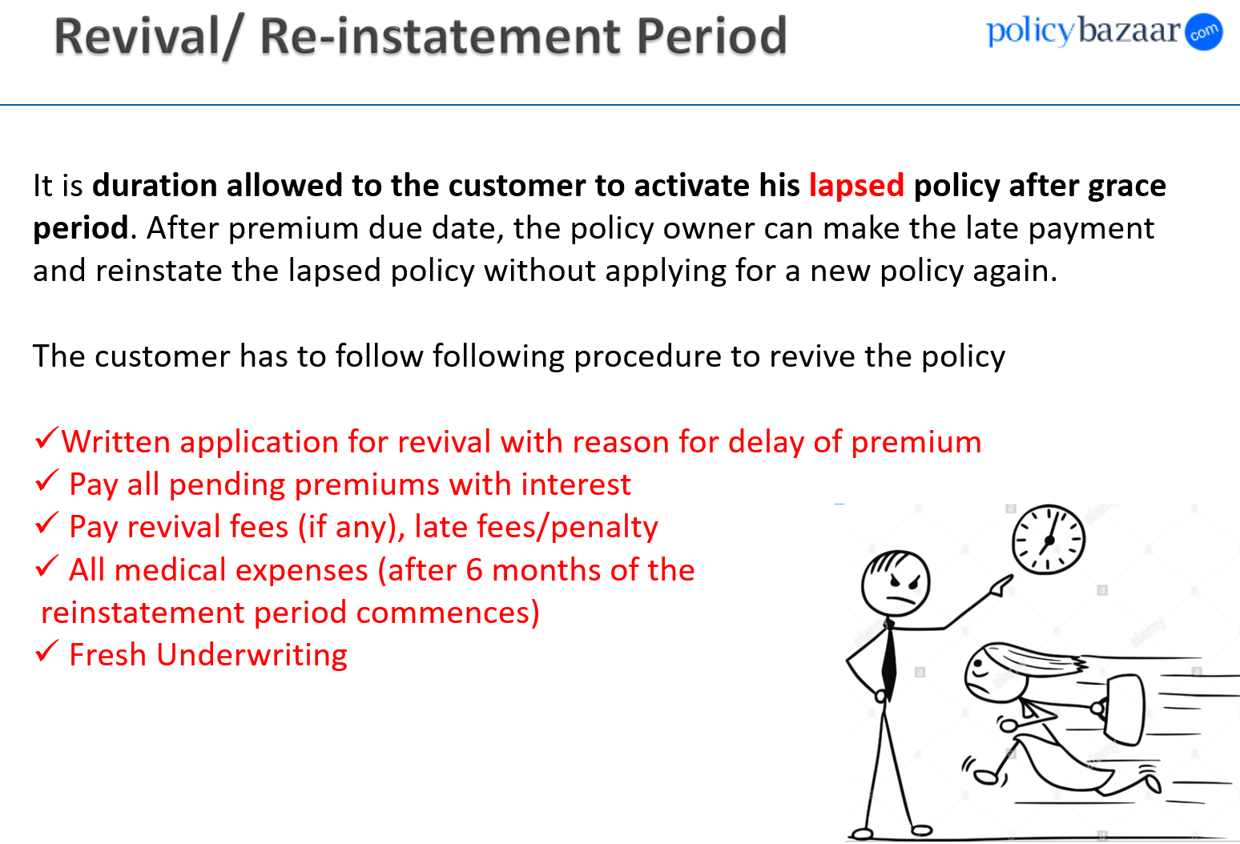

Slide 19
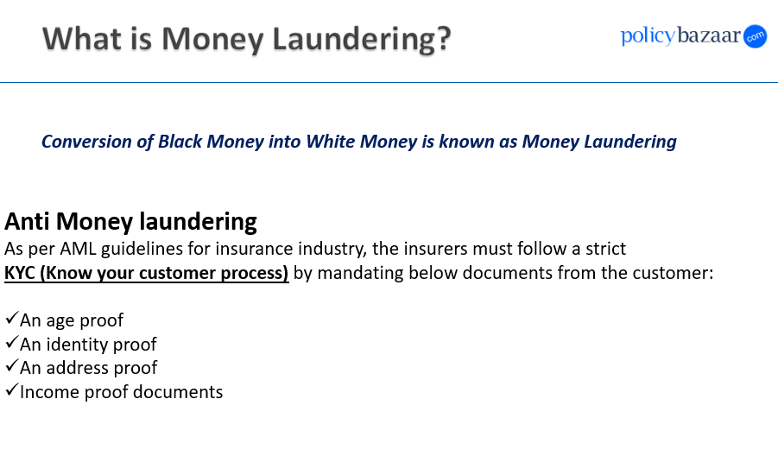

Slide 20
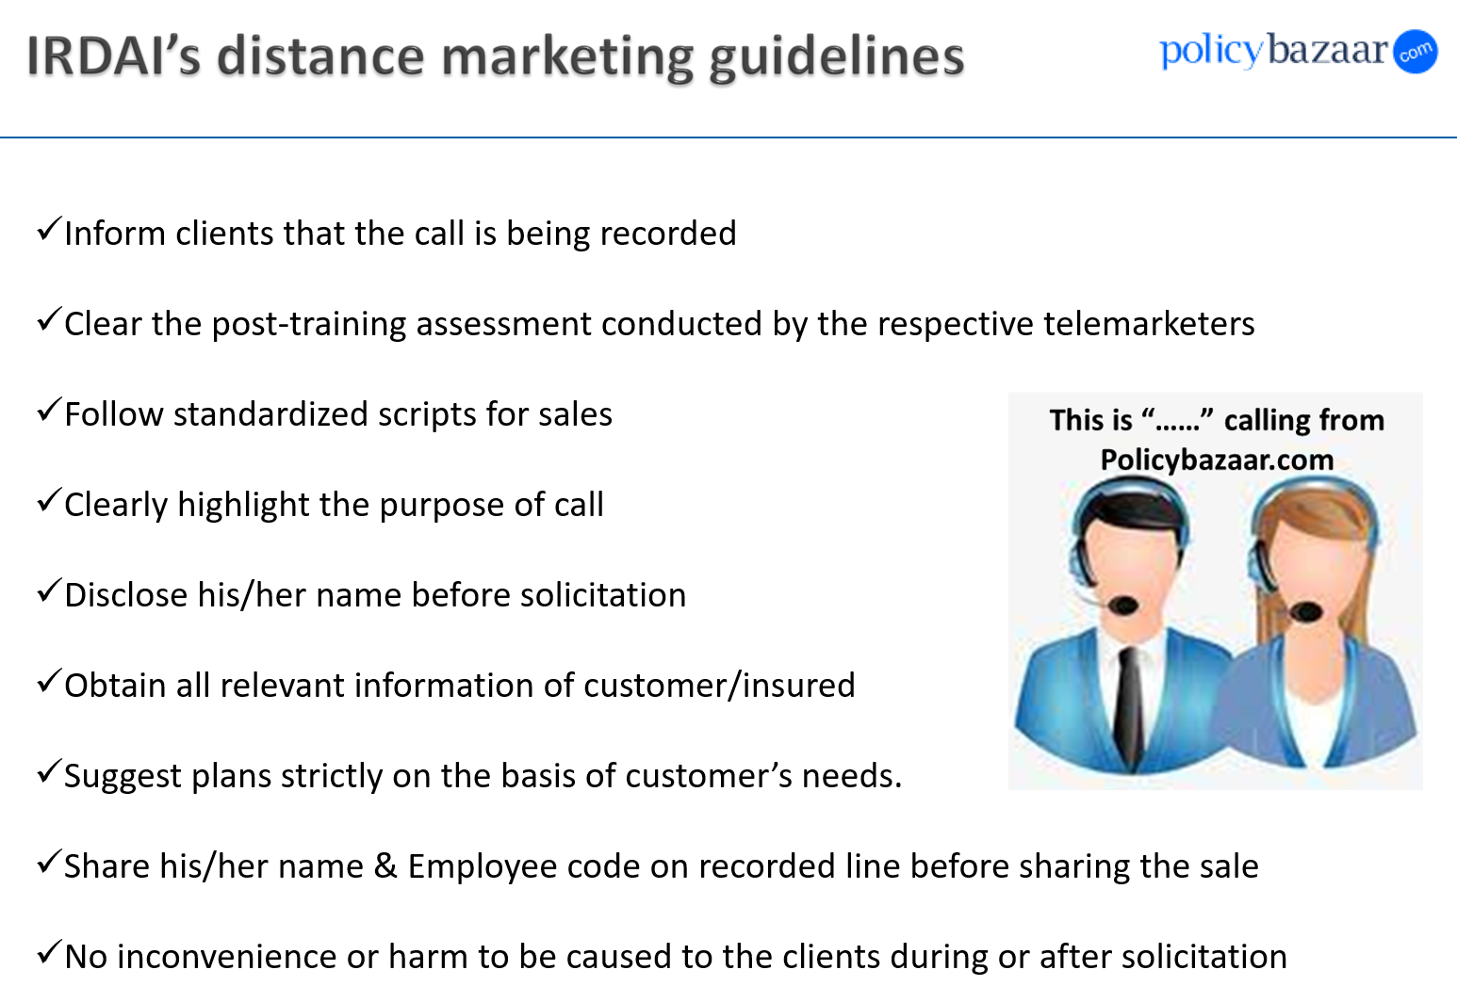
Transparency is maintained with customer

Slide 21
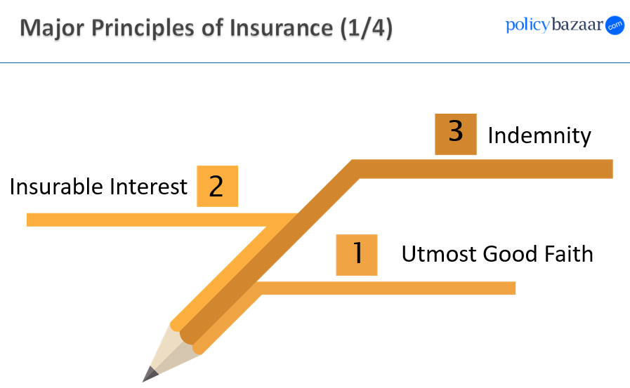

Slide 22
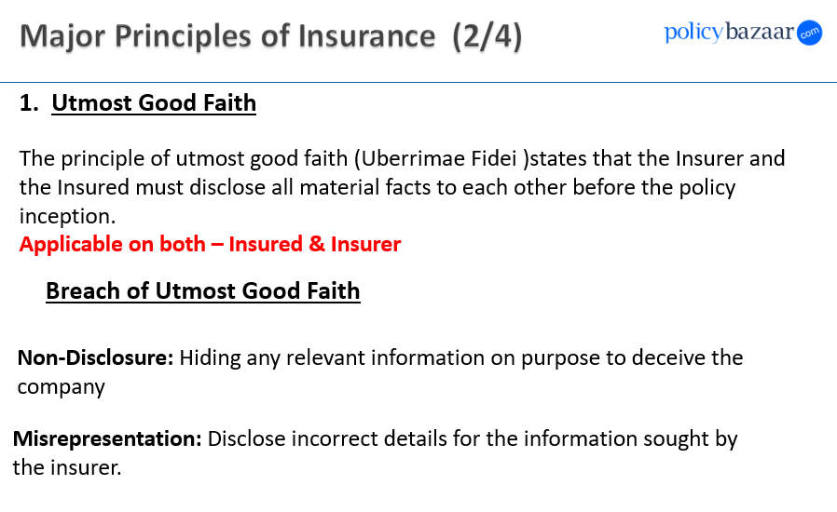

Slide 23
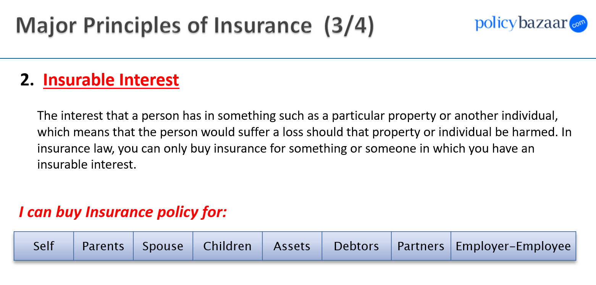

Slide 24
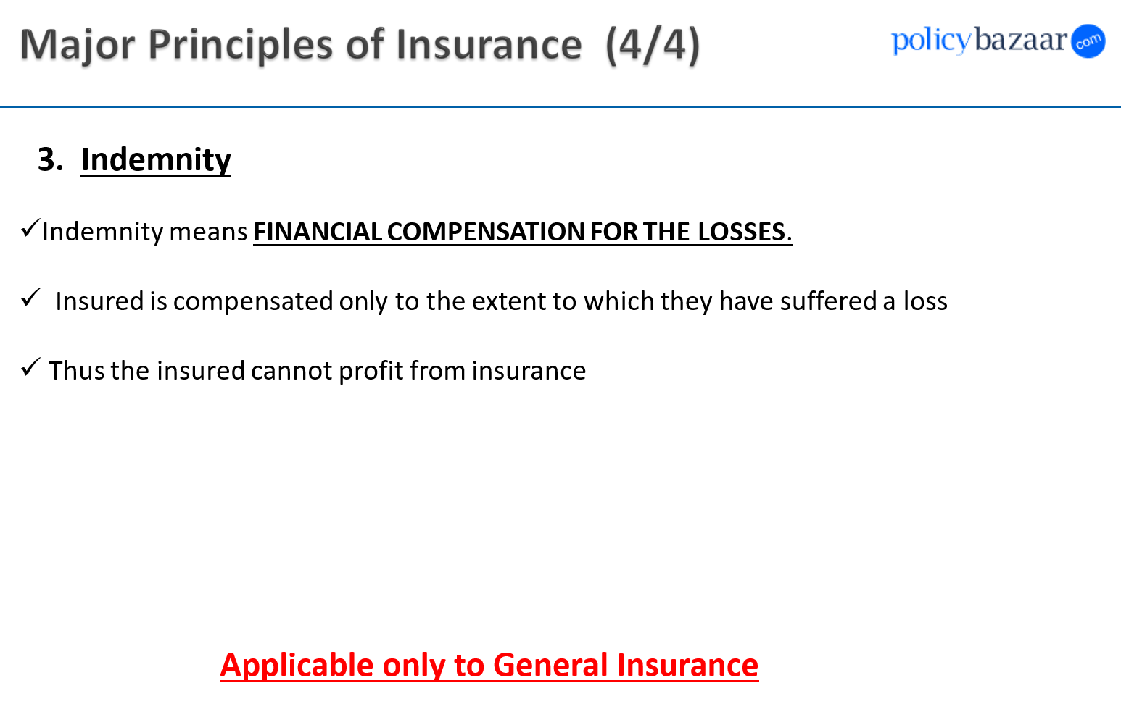

Slide 25
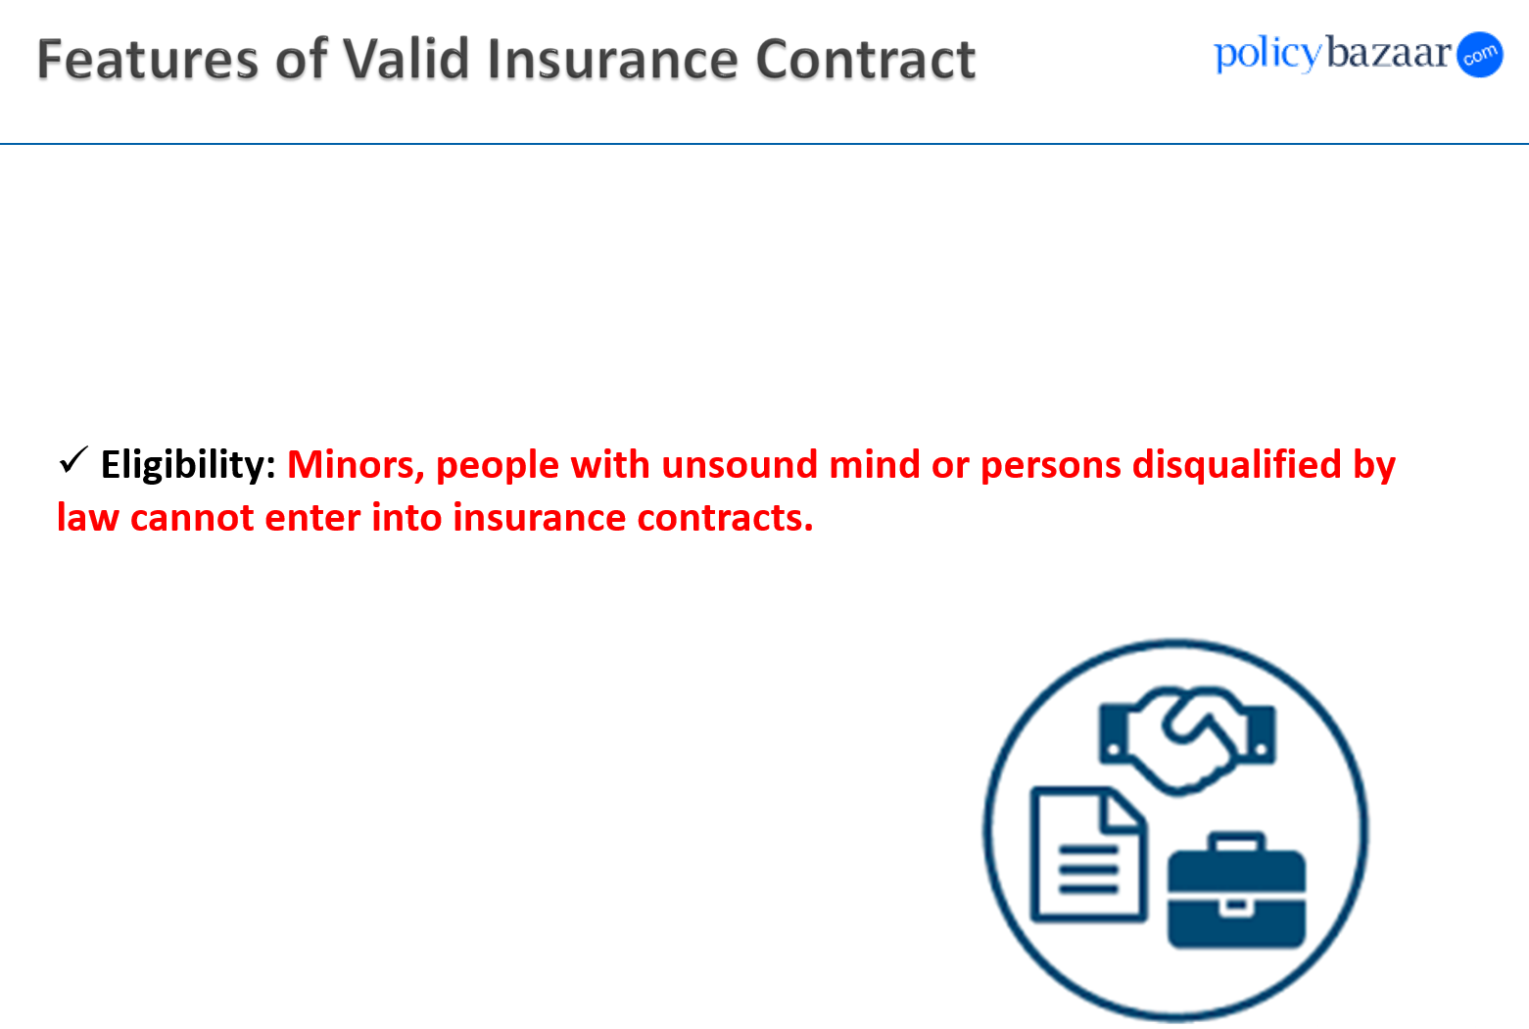

Slide 26
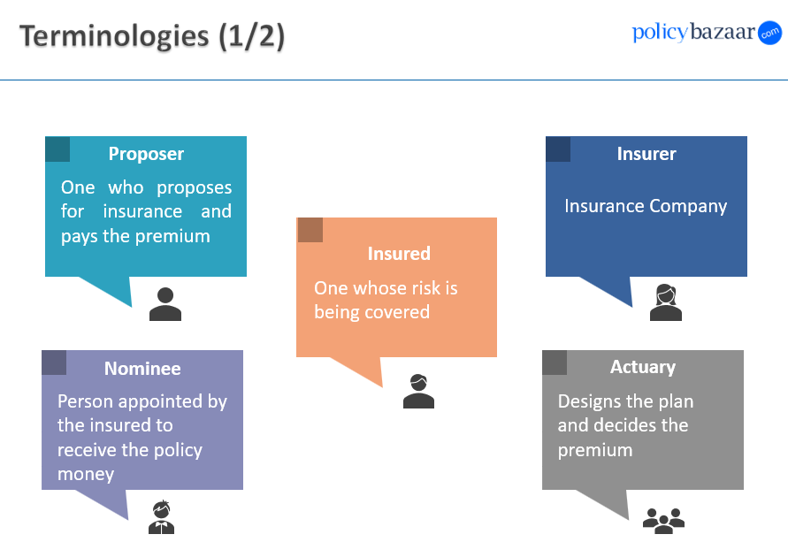

Slide 27
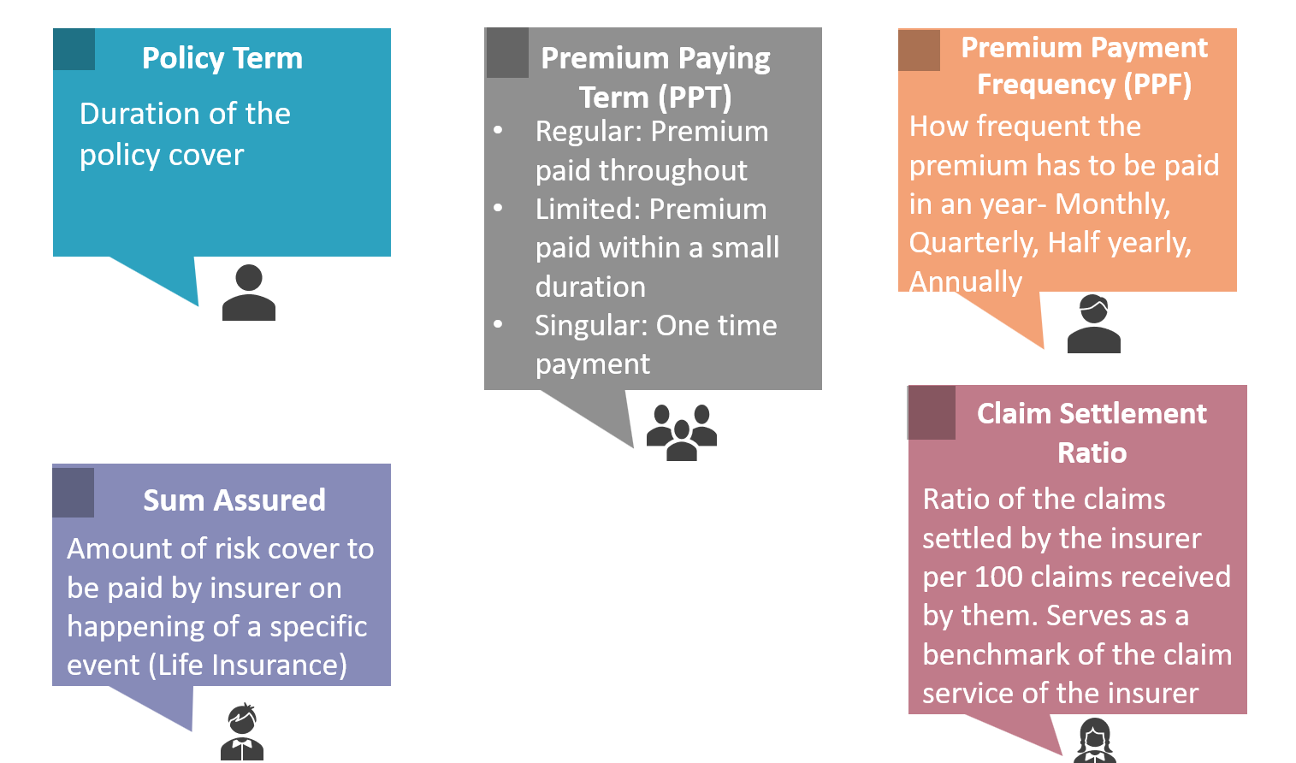

Slide 28


Slide 29
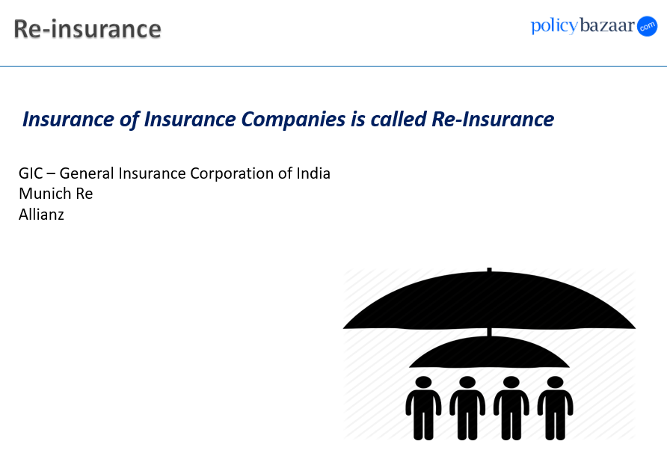
Swiss Re

Slide 30
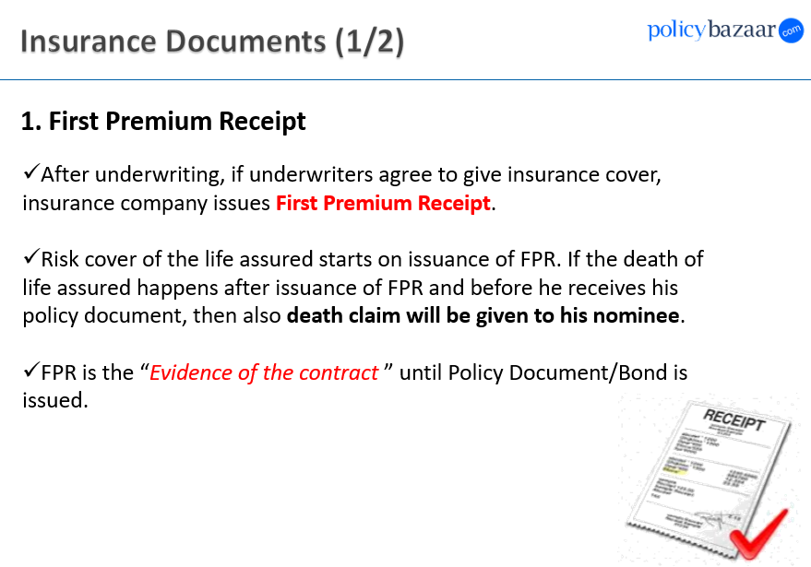

Slide 31
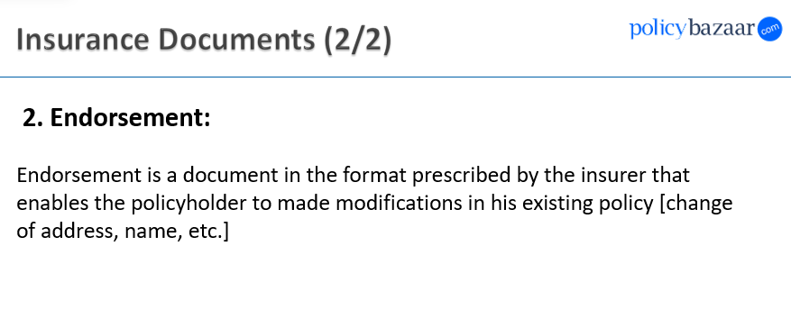

Slide 32
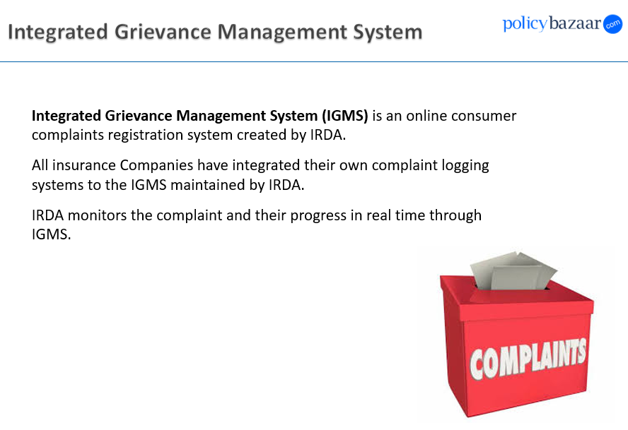

Slide 33
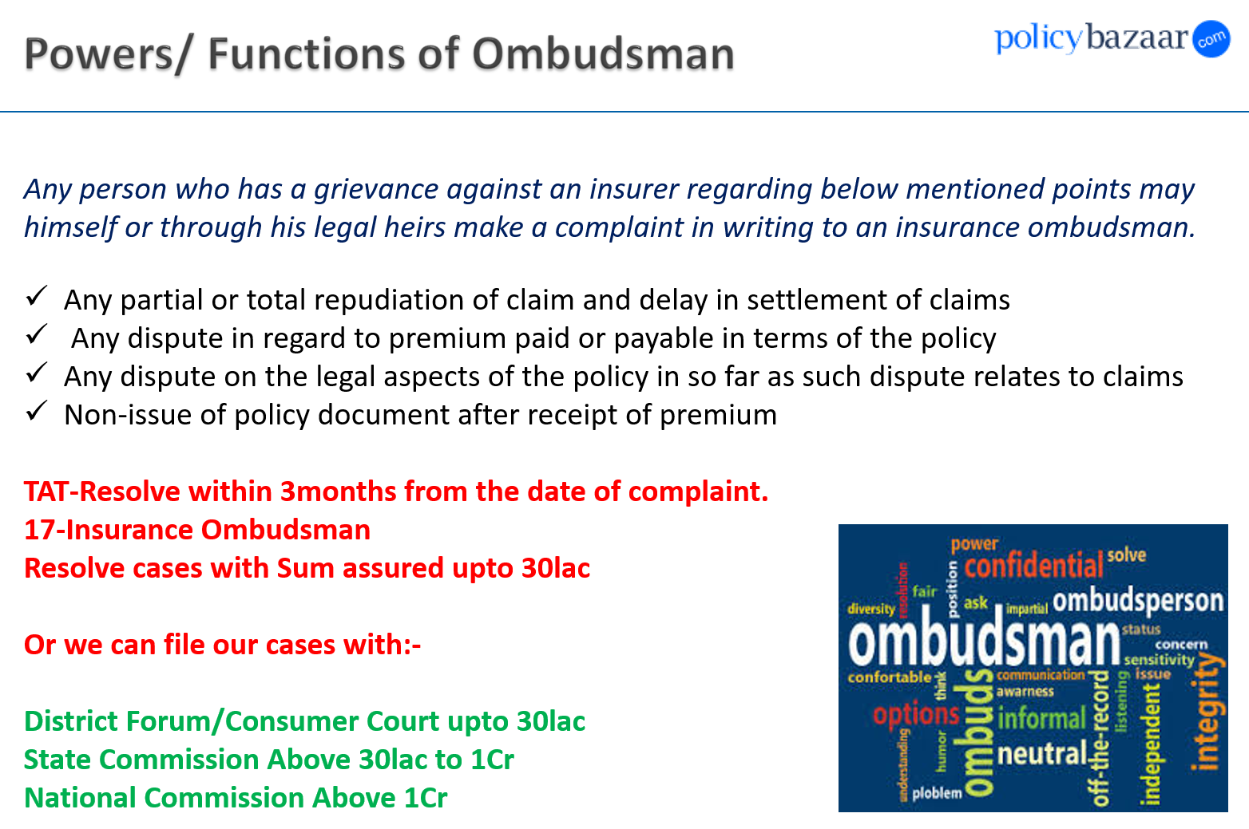

Slide 34
